Slide 1
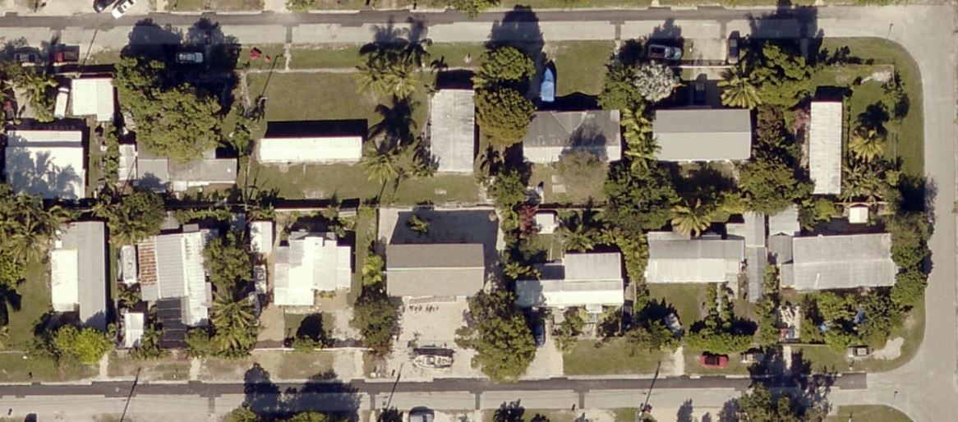
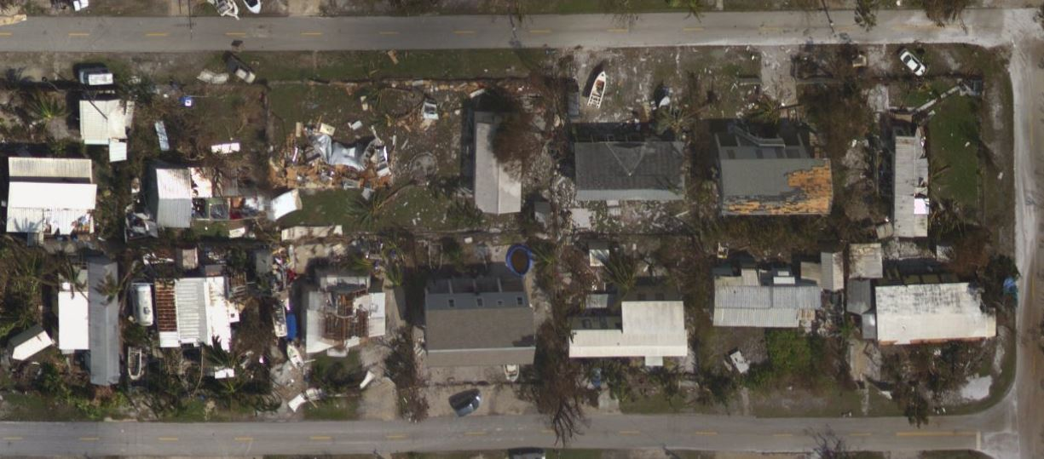
WHY this is important ?
Can we estimate the impact just base on a satellite images?

Slide 2
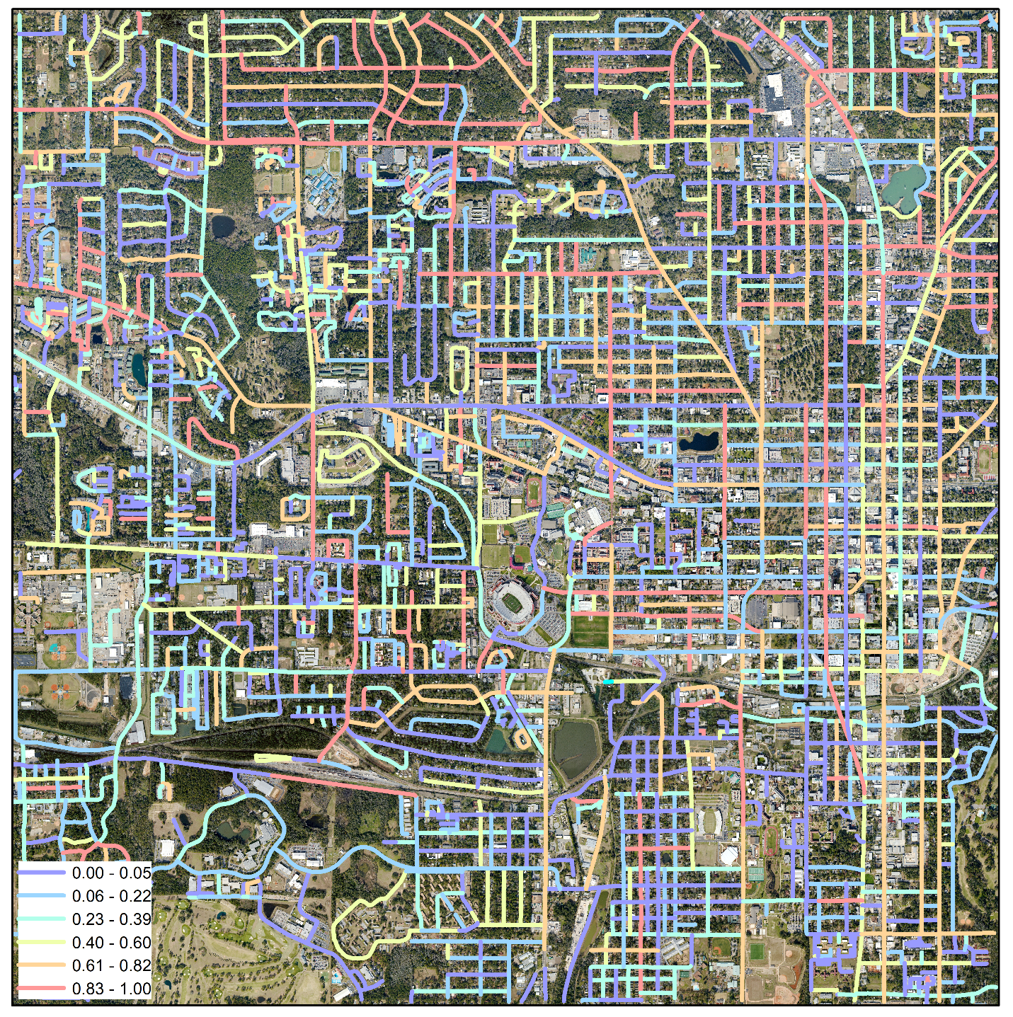
Probability of road closure in city of Tallahassee during the Herminie

Slide 3
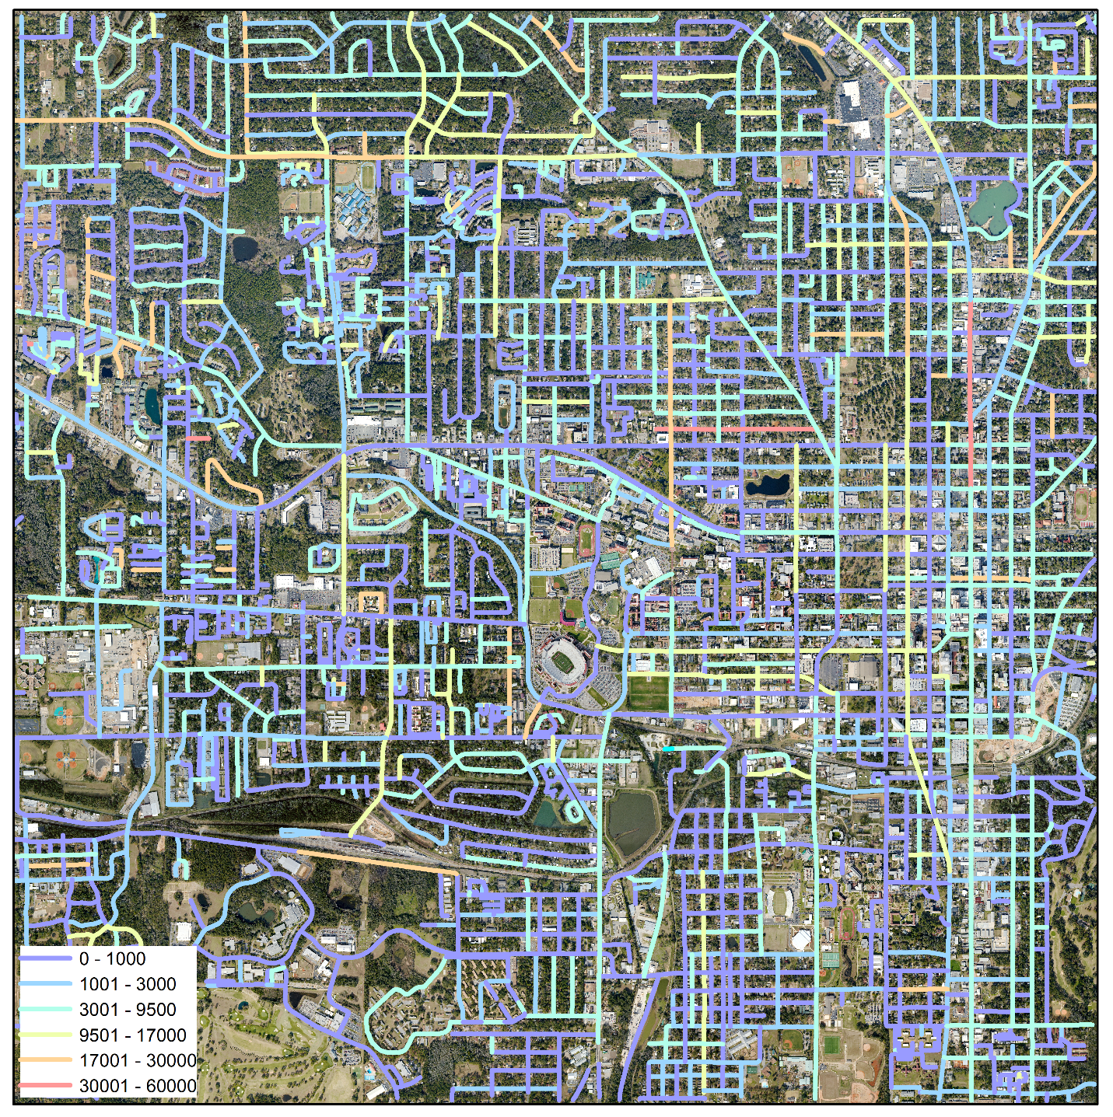

Tree debris estimation
$$M_{f}(v)=\sum_{i=1}^{N}{F_{R_{i}}(v)∙m_{f_{i}}}$$

Slide 4
Validation
Probability of road closure in city of Tallahassee during the Herminie

Slide 5
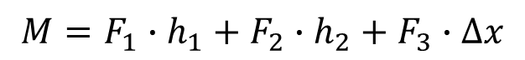

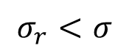
Tree model used for the fragility estimation
1) Initialize the tree parameters from the regression $N(μ=0, σ^{2}=CI(d_{cr}))$;
2) For each wind speed calculate the load and record if the tree was destroyed
3) Repeat the steps 1 & 2 $m$ times;
4) Calculate the fragility for the crown size as the mean over all simulations.
$$M=F_{1}∙h_{1}+F_{2}∙h_{2}+F_{3}∙∆x$$
$$σ_{r}<σ$$

Slide 6
Validation
Tree debris estimation
$$M_{f}(v)=\sum_{i=1}^{N}{F_{R_{i}}(v)∙m_{f_{i}}}$$

Slide 7
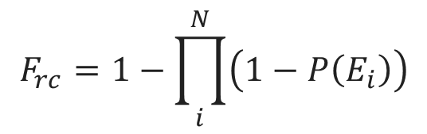
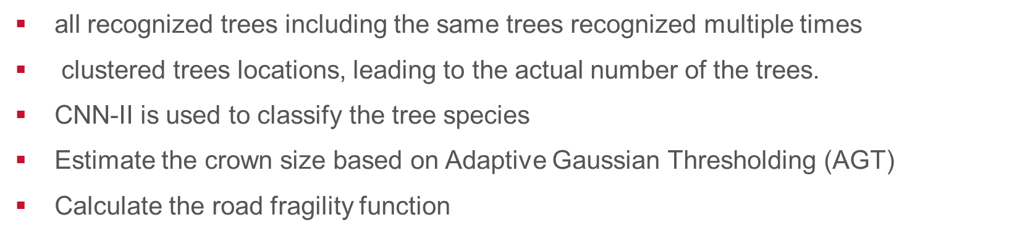
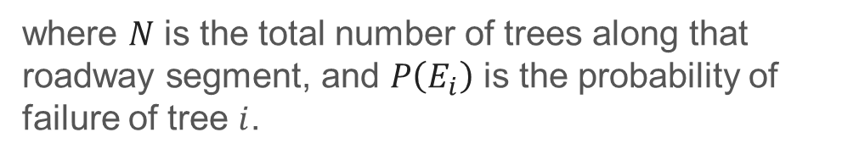
Probability of road closure
all recognized trees including the same trees recognized multiple times
clustered trees locations, leading to the actual number of the trees.
CNN-II is used to classify the tree species
Estimate the crown size based on Adaptive Gaussian Thresholding (AGT)
Calculate the road fragility function
$$F_{rc}=1−\prod_{i}^{N}{\left(1−P\left(E_{i}\right)\right)}$$
where $N$ is the total number of trees along that roadway segment, and $P\left(E_{i}\right)$ is the probability of failure of tree $i$.

Slide 8
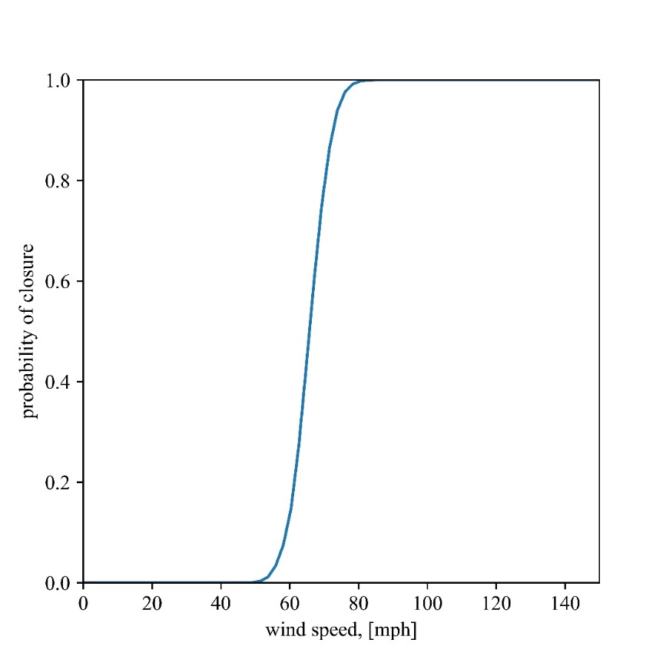
fragility curve for road closure
the wind speed in Tallahassee was approximately 64 mph, which represents around 0.4 probability that this road was closed. Up to 50 mph, this road is not expected to be influenced by the tree failure

Slide 9
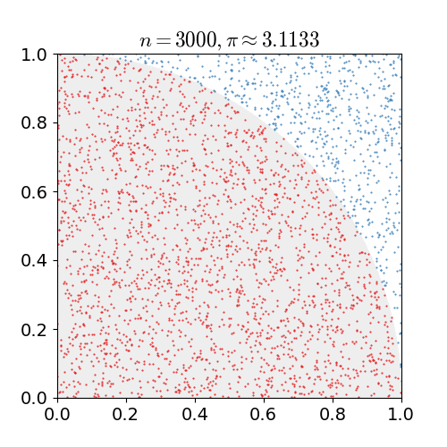
Monte Carlo estimation for tree fragility

Slide 10
Tree fragility functions PITA-lobby pine
the Monte Carlo simulation was used to estimate the family of fragility functions for each type of the tree with respect to the crown size

Slide 11
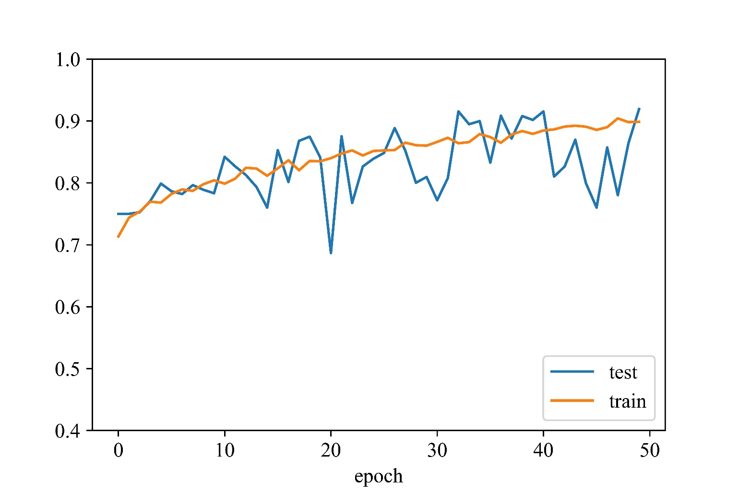
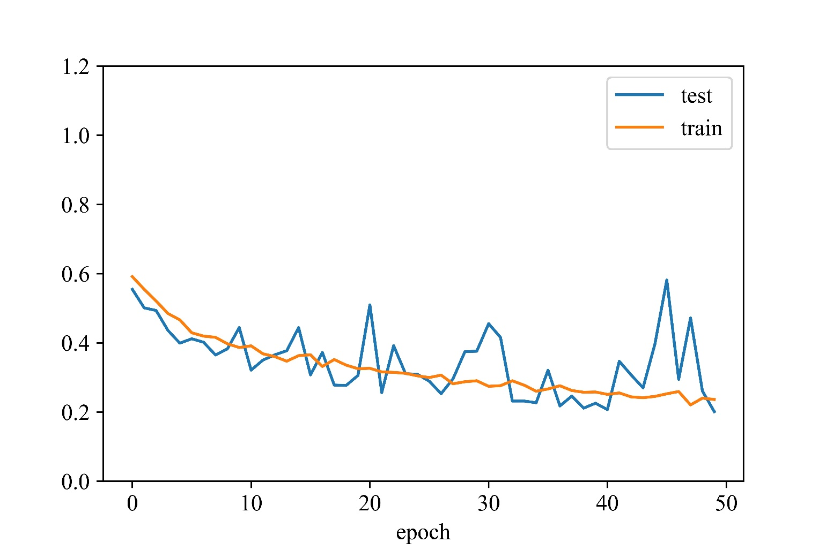
Accuracy
Loss -Cross-entropy

Slide 12
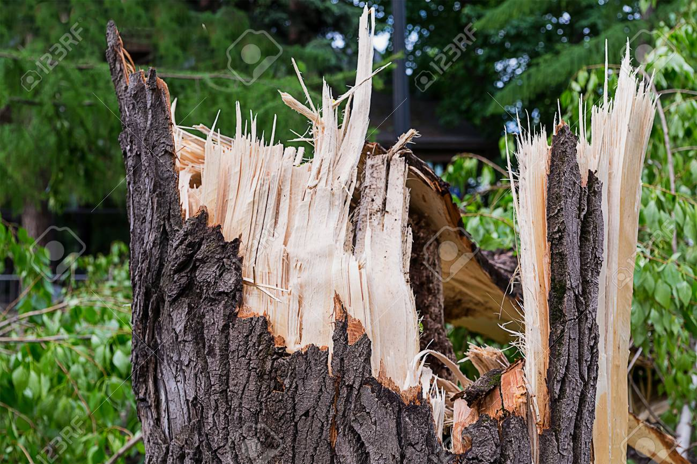
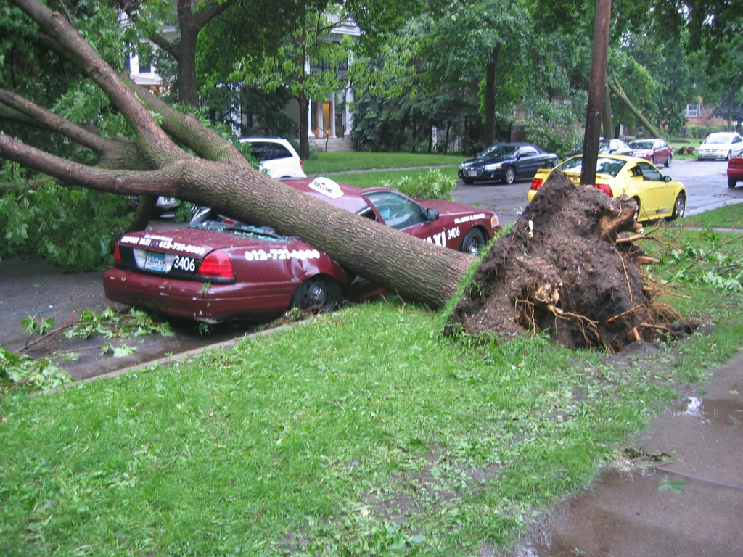
Modeling tree failure model
Failure of the tree where the tree is not able to resist the load from the wind and the trunk is destroyed by bending
Failure due to the soil conditions where the tree is being pulled from the ground without the damage to the tree
The scope of this research is limited to the second type of the failure, because of lack of knowledge of soil conditions in city of Tallahassee. Moreover, most of the trees observed after the Hurricane Hermine were destroyed by the bending.

Slide 13
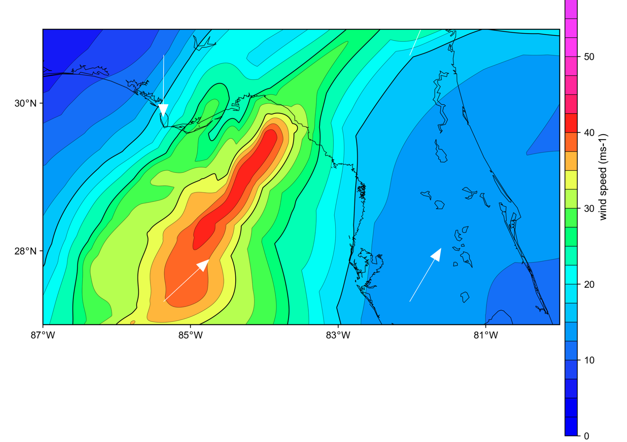
The peak 3-sec gust marine wind speed for the Hurricane Hermine
wind speed in Tallahassee was approximately 64 mph

Slide 14
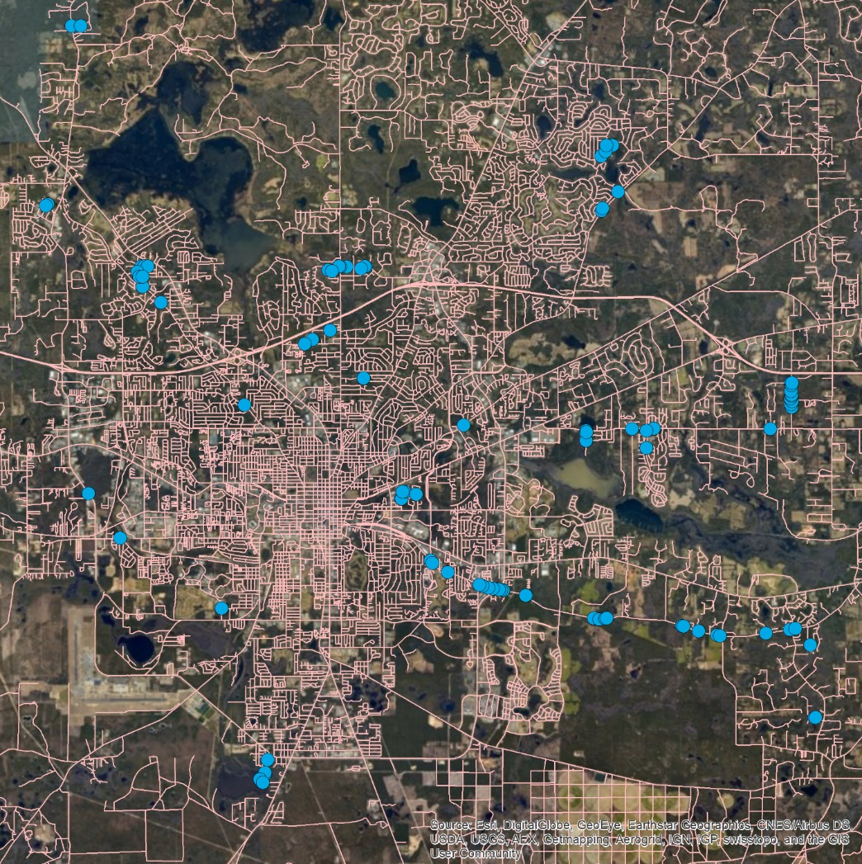
Collected data of the destroyed trees by Hurricane Hermine in Leon County.
the locations of the destroyed trees. A total of 137 cases were examined. This data was used in validation of the proposed approach.

Slide 15
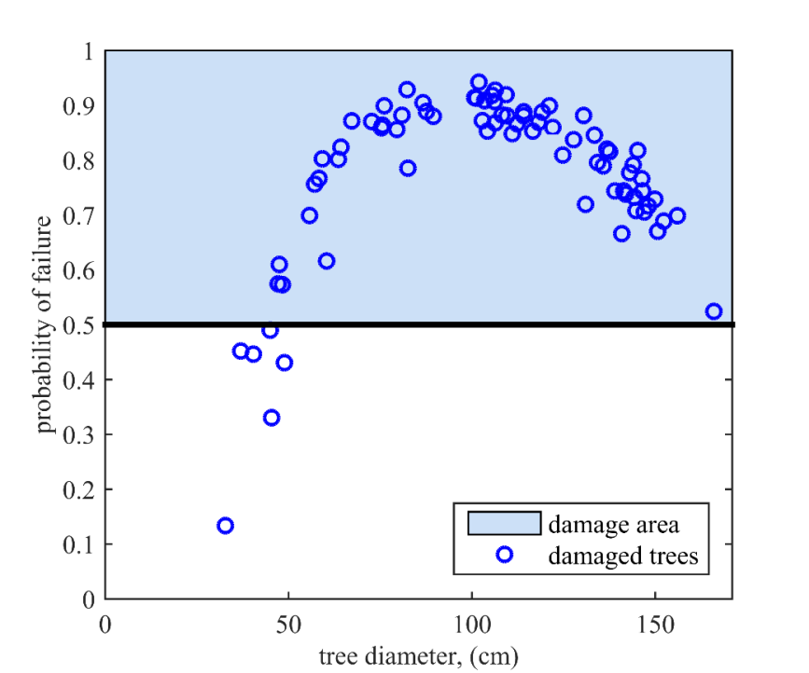
Comparison of the fragility model and damaged trees after Hurricane Hermine
Comparison of the fragility model and damaged trees after Hurricane Hermine.

Slide 16
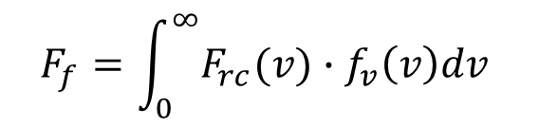
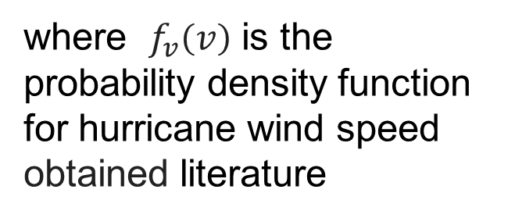
Probability of road closure considering the wind distribution
$$F_{f}=\int_{0}^{∞}{F_{rc}(v)∙f_{v}\left(v\right)dv}$$
where $f_{v}\left(v\right)$ is the probability density function for hurricane wind speed obtained literature

Slide 17
Probability of road closure considering the wind distribution
$$F_{f}=\int_{0}^{∞}{F_{rc}(v)∙f_{v}\left(v\right)dv}$$
where $f_{v}\left(v\right)$ is the probability density function for hurricane wind speed obtained literature

Slide 18
QUVI

Slide 19
LIST

Slide 20
PIEC

Slide 21
PITA

Slide 22
QUVI

Slide 23
LIST

Slide 24
PIEC

Slide 25
PITA

